Slide 1

RNFOO Orientation for
2026 Reviewers

Slide 2
Agenda:
Introductions
Overview of Review Process
Reviewing Platform

Slide 3
Preparation for Review Process
By January 27th: Messages from the office will “e-introduce” team members to each other; login details and rubrics will be distributed. Contact your co-reviewer to arrange the time to meet and review scores at this point.
By January 30th: Lists of applicants assigned to your team will be circulated. PLEASE review this list upon receipt
. If there is someone in the group that you know well, inform the office by Tuesday, February 3, 2026 to ensure we are able to make relevant changes.

Slide 4
Overview of Review Process
Step 1: Reviewers score each applicant independently
Step 2: Co-reviewers meet to review their independent scores, arrive at a single score that will be submitted for each applicant.
Step 3: Co-reviewers consider top scoring applicants, decide which awards these ‘contenders’ are most suited to a specific award and why. The reviewer attending the Review Panel meeting come prepared to present contenders to the Panel.
Step 4: Completed score sheets must be submitted to the office by noon on Friday, February 20th.

Slide 5
Confidentiality of Applicants’ Information
On initial login reviewers will be asked to read RNFOO’s Confidentiality Policy. Finalizing the login is taken as acceptance of this Policy.
Registered Nurses’ Foundation of Ontario Confidentiality Policy and Agreement The Registered Nurses’ Foundation of Ontario (RNFOO) has a privacy policy that is in keeping with Canadian legislation. Members of the Review Panel have access to confidential information provided in Academic Awards applications. By continuing to login to the judging platform, you agree to use this confidential information for the sole purpose of scoring the applications, and to keep all information in the strictest confidence.
While doing your scoring, please remember to keep applications and scoring sheets secure for confidentiality and privacy purposes. When you are finished, please permanently delete all files, and securely destroy all papers.

Slide 6
Getting Started
As you prepare to score applications, you may find it helpful to print or have the RNFOO 2026 Awards & Scholarships Brochure open.
Please note, there are separate scoring workbooks for each level with individual sheets for each applicant
If you print rubrics, please remember to protect the documents for confidentiality and privacy purposes. When you are finished, please permanently delete all files from your computer, and securely destroy all papers.

Slide 7
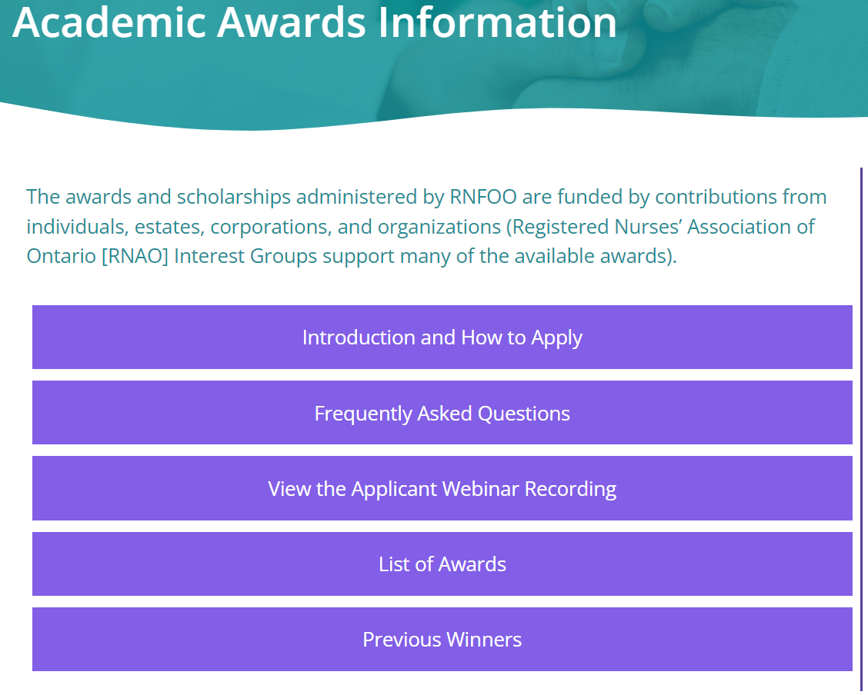
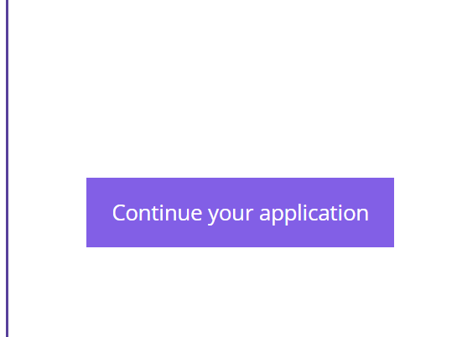
Accessing Applications
Step 1: Use this URL to access the reviewer’s login:
https://www.rnfoo.org/academic-awards-information/
Step 2: Click on the ‘Continue your application/ Log in to access applications’ button

Slide 8
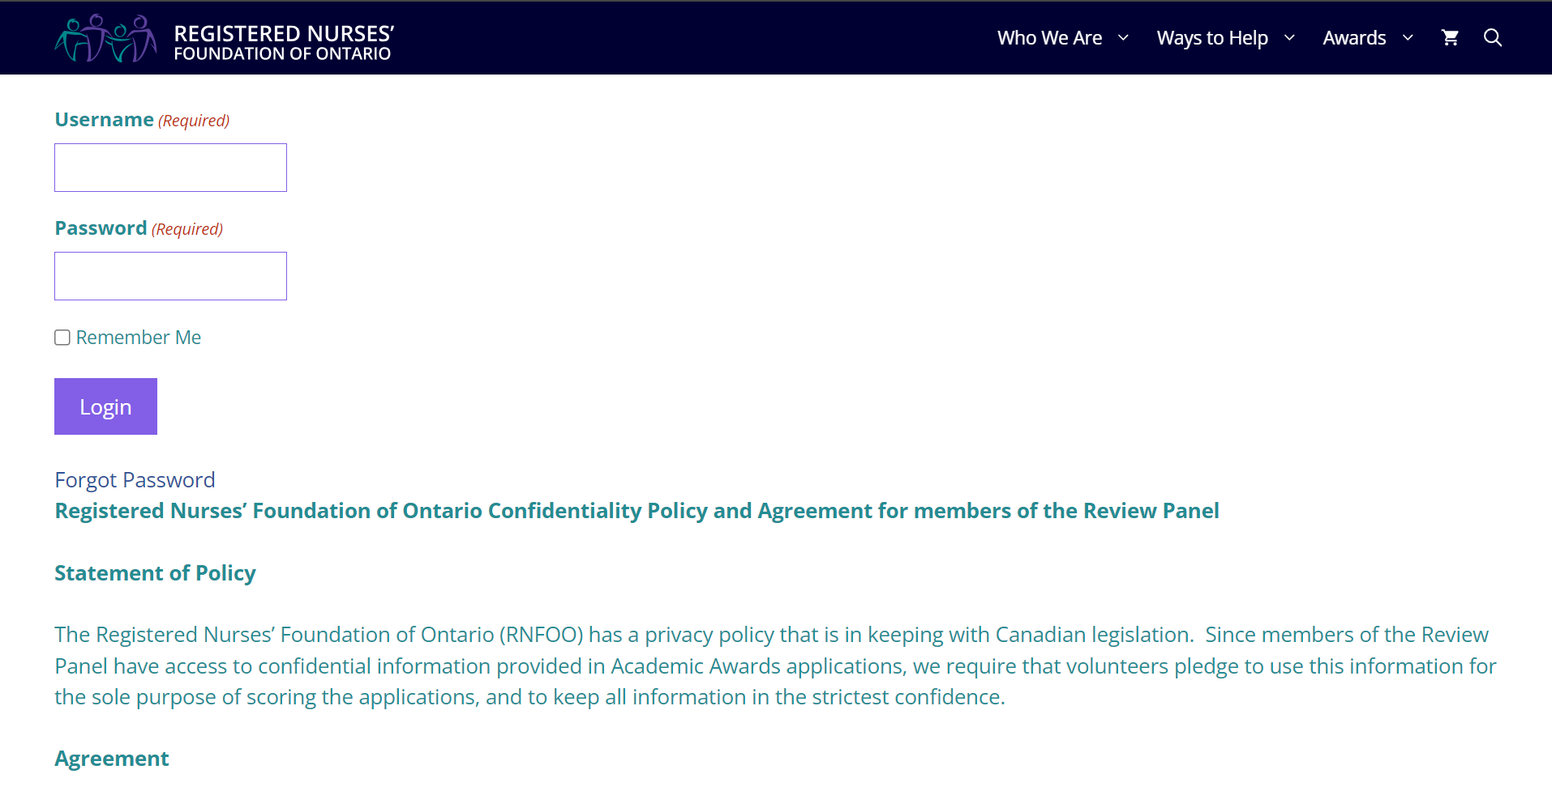
Accessing Applications
Step 3: Enter your details
⇐The Confidentiality Policy

Slide 9
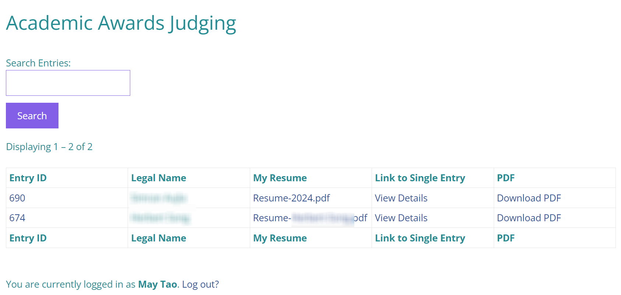
Team Lists
When you click “Login”, you will be taken to the list of applicants you will be reviewing:

Slide 10
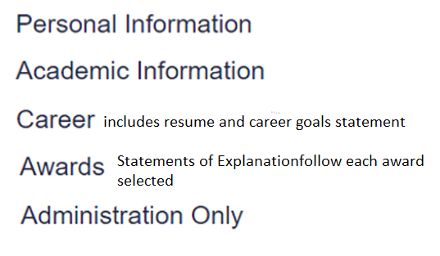
Organization of information
The application appears as one continuous page under headings that always appears in the same order. Keep scrolling to access the data you require.
If you find information in the body of the application that contradicts the Academic Program identified, please contact the office as soon as possible. We will need to reassign that applicant to the correct review team.

Slide 11
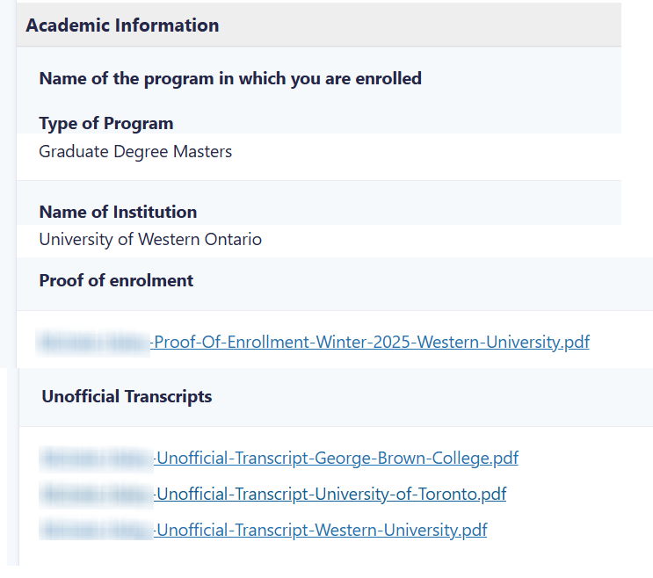
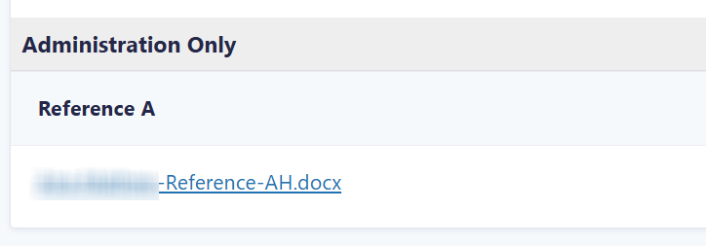
Documents
Confirmation of Enrollment (Reviewers to confirm Winter 2026 enrollment) and Unofficial transcripts are in the Academic section
Reference letters are found in the Administration section at the end of the application

Slide 12
Rubrics
Rubrics are available in Word or Excel.
Rubrics can be downloaded from the Reviewer’s
Resources page of the RNFOO website.
All applications are scored on the same topics; rubrics have been adjusted to expectations reasonable for the various academic programs.

Slide 13
An important note about documents
The application form has required fields to ensure that relevant files have been uploaded. The content of these documents has not been reviewed.
RNFOO office staff upload reference letters. If you find anything unexpected in the uploaded documents (perhaps the same reference letter uploaded twice, or a different student’s reference loaded) please contact the RNFOO office. Among the hundreds of documents we upload, we may have selected the wrong one – that doesn’t necessarily mean that we don’t have the right one.

Slide 14
References
Applicants are encouraged to provide the RNFOO instructions for reference letters to their referees.
However, not all applicants have provided this information to their referees, and even when they have, not all referees have followed these instructions. If you are concerned about the authenticity of a reference letter, please consult with your reviewing partner and contact the RNFOO office as soon as possible.
While our instructions request that letters be provided on letterhead, please note that often clinical instructors don’t have access to letterhead.

Slide 15
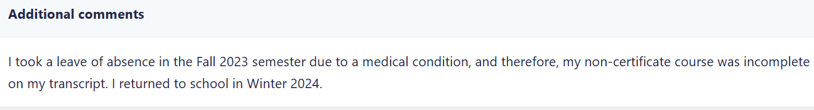
Additional Comments
Please check the ‘Additional Comment’ field at the end of the Academic Information section. Applicants are encouraged to use it to explain special circumstances or provide additional information.

Slide 16
Selection of Awards
Applicants do not have opportunity to apply for awards where the criteria did not meet their academic program.
After you have scored the applications, you should consider the statements made by stronger applicants to determine whether or not they are good candidates for any particular award.

Slide 17

Eligibility for Awards
This is the stage at which familiarity with the criteria of available awards is important. The Awards Brochure describes all of the Awards and Scholarships that are available for this year.
The 2026 Awards Brochure is accessible from a link at the bottom of the Application Guidelines page of the website, and on the Reviewer Resources page.

Slide 18


Award Backgrounds
If you are not familiar with the awards available, reading about the backgrounds can help you to notice the best fits between strong applicants and particular awards.

Slide 19
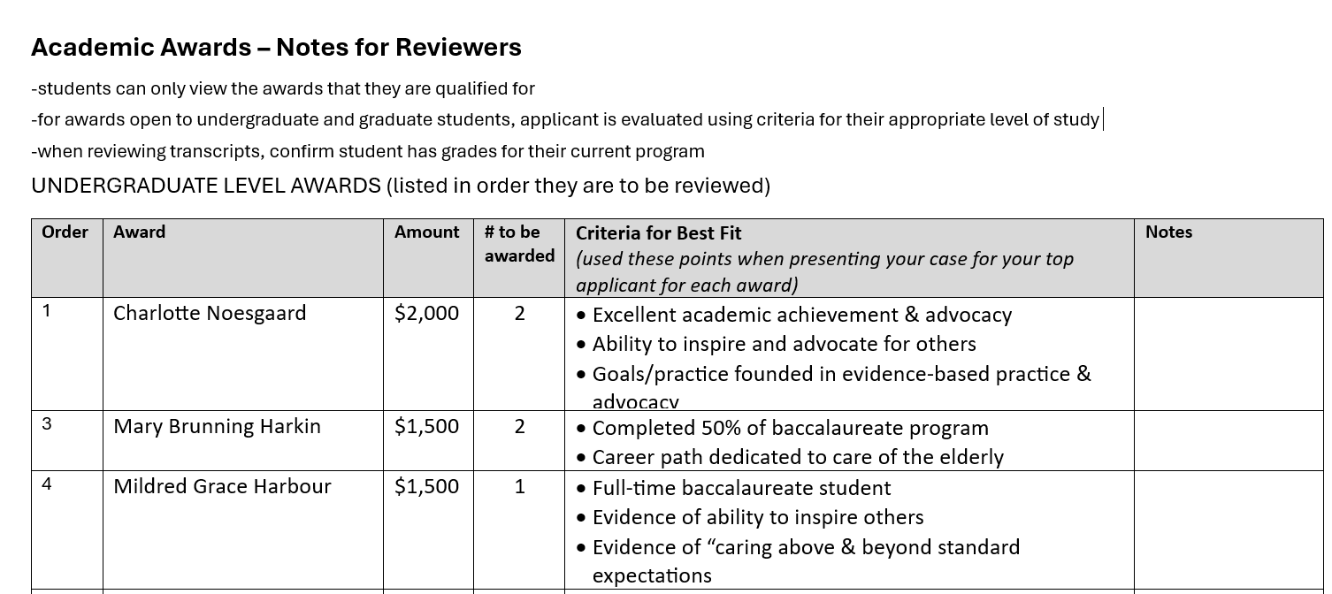
Using the RNFOO Criteria Guide To find the Best ‘Fit’
We recently introduced a guide to facilitate discussion of the best applicants for each award. The reviewer(s) who will attend the Review Panel Meeting should bring detailed notes with them.

Slide 20
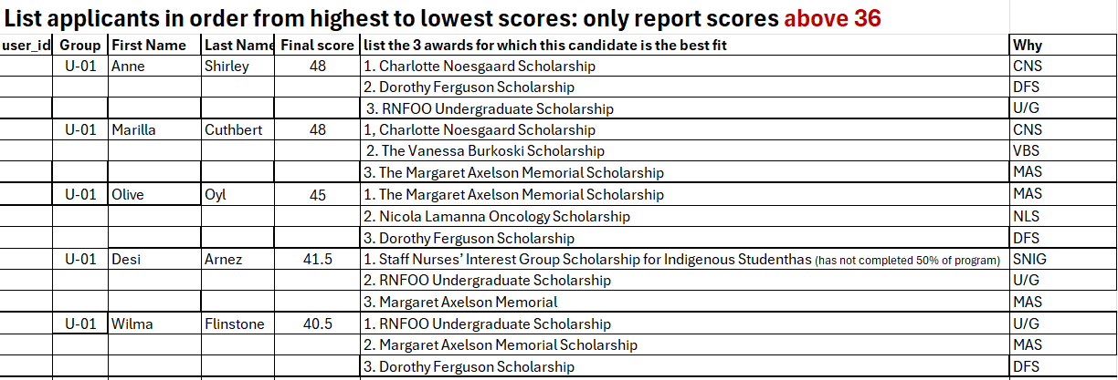
Sample of Scoresheet using Best Fit guide
Notes in the “Why” column are for use of the reviewer who will be attending the Review Panel Meeting. These are the points you should be ready to share with the Review Panel. They are also important to have ready in case something drastic comes up, and someone has to take over presenting applicants at the Meeting.

Slide 21
Review Summary
Reviewers score each applicant independently, according to the rubric provided.
Teams meet to:
discuss their scores for each applicant
through negotiation, determine one set of scores to be submitted to the RNFOO office
identify your strongest applicants
suggest which awards those strong applicants should be considered for (There is no need to discuss applicants who score less than 36/48)

Slide 22
Dates
Final scores must be submitted to the office by noon on Friday, February 20th.
Reviewers attending the Review Panel meeting on February 26th (RPN and Undergrad) or February 27th (Grad) should be prepared to provide further details about the strengths of the strongest applicants relevant to the award(s) for which they are best suited.
When you have finished scoring your applicants and submitted your scores, please remember to permanently delete the files from your computer and shred any documents that you have printed.

Slide 23
Scoring Process with Partner(s)
Score a few and review with partners (consistency in scoring)
Continue to review independently
Compare scores for all applicants with partners
Select number 1 applicant for each award
Submit final scores on time (NOON Friday, February 20)
Note
– applicants may apply to multiple awards. Your role is to choose the award that aligns best with their application.
- declare conflict of interest if you know any applicants in your pool

Slide 24
General Tips
Review scoresheet
Identify data source on website for each criteria on scoresheet

Slide 25
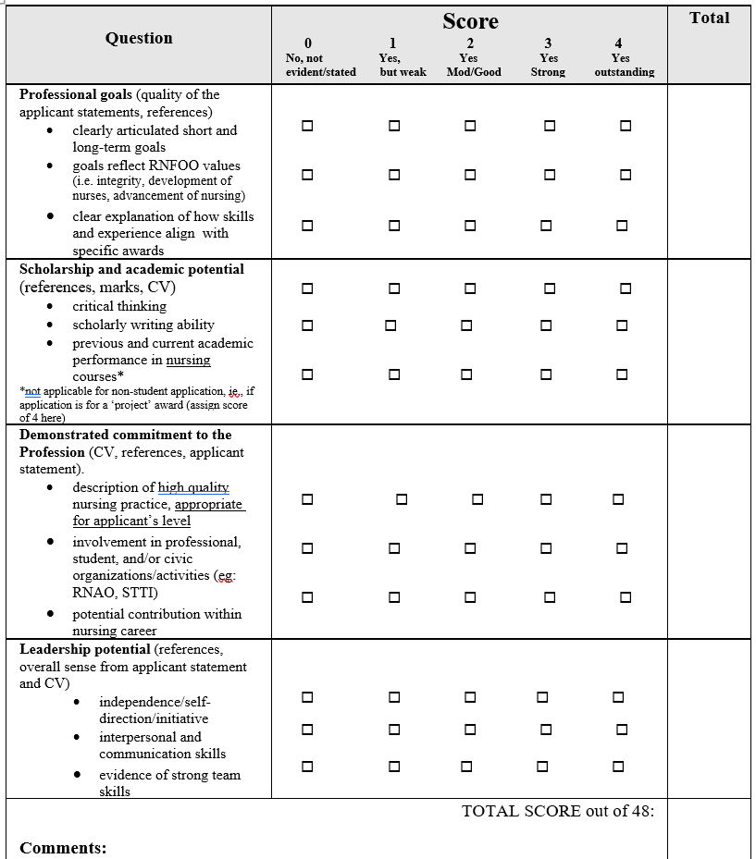
Sample Scoresheet: Undergraduate
What are you bringing to the profession as an individual (applicant statement – e.g., advocacy)
Going beyond, collaborative team member, influence others

Slide 26
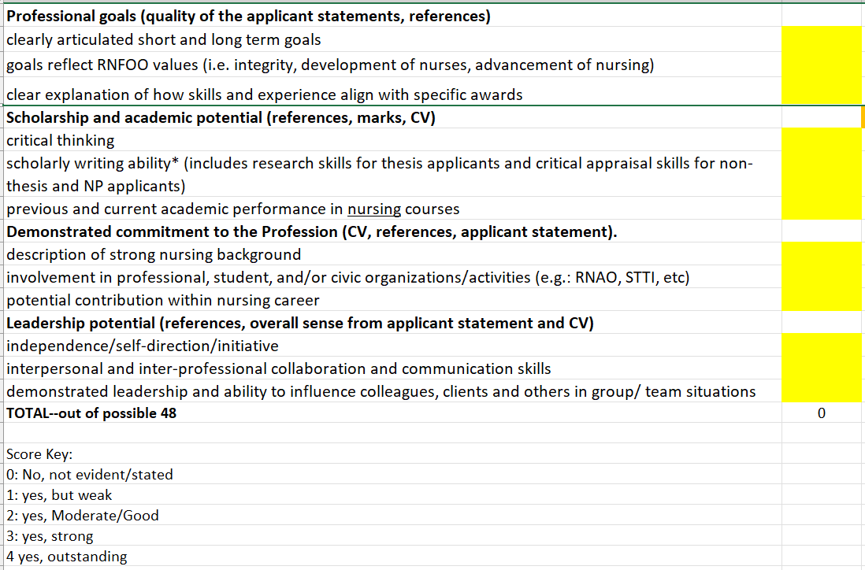
Sample Scoresheet: Graduate
State how it is the same or different from undergrad scoresheet
Expect more examples as applicants are more experienced as a clinician

Slide 27
Scoring - General Tips
Look for concrete examples
Evaluated according to the of level of study (student vs practising nurse)
Review ‘Awards criteria’:
Ensure applicant meets criteria for EACH award they selected (different statements for each award)
Focused activities and align with award e.g. committee work, courses, PD, work experiences and skill set
Make notations for areas of excellence or gaps/issues

Slide 28
Research Grants
Completed research proposals (year 2 or 3 in PhD programs; in progress research for Master’s programs)
Follow Research Guidelines (e.g., length) and grant criteria
Alignment with the focus of the award
NRIG – generic (1)
MHNIG – mental health care (2)
DNIG - diabetes care (1)
Lynn Kirkwood – Nurse Practitioner practice (all domains) (1)

Slide 29
Prepare for Reviewer Panel Meeting
“Tell me more about your applicant….”
Select recommended award best suited for applicant
Provide rationale - be prepared to champion your applicants
Assemble materials for quick reference:
Completed scoresheets
Award criteria
Know your group number

Slide 30
Review and Selection Process
Initial look at display documents for Review Panel by the A & S Committee
Awards are considered in order of monetary value then by specificity of criteria
Applicants may win more than one award
Minimal score to be selected for an award is 36/48
If selection of winner is unclear, random selection process will be done
Post meeting:
Verify and review of official transcripts
Notify award winners and Schools of Nursing
Follow up documentation
Celebration!

Slide 31
Q & A – open discussion

Slide 32
Thank You!
If questions, contact Leah...

Slide 33
Discussion
If you have any questions about any of the information presented here, please contact Leah. If she can’t answer your questions, she will connect you with a committee member who can.
leah.dooley@rnfoo.org

